Slide 1
Excelerate Learning Path Analysis
Analyzing learner data to generate insights for Excellerate strategy
Date: 5 Jan 2026

Slide 2
Problem Statement:
How do learners actually progress through the Excelerate funnel?
What patterns appear in wait times, onboarding delays, and dropout rates?
How can Excelerate use these insights to fix bottlenecks and boost retention?

Slide 3
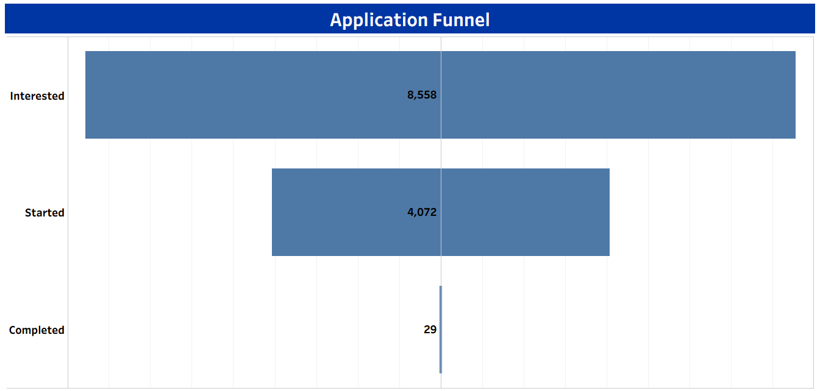
8,500+ Applicants, But Very Few Finishes
8,558 people applied, so our marketing works.
Nearly half of them never even start.
Only 29 students finished, which means something is blocking them.
We don't need more applicants; we need to fix the path for the ones we have.

Slide 4
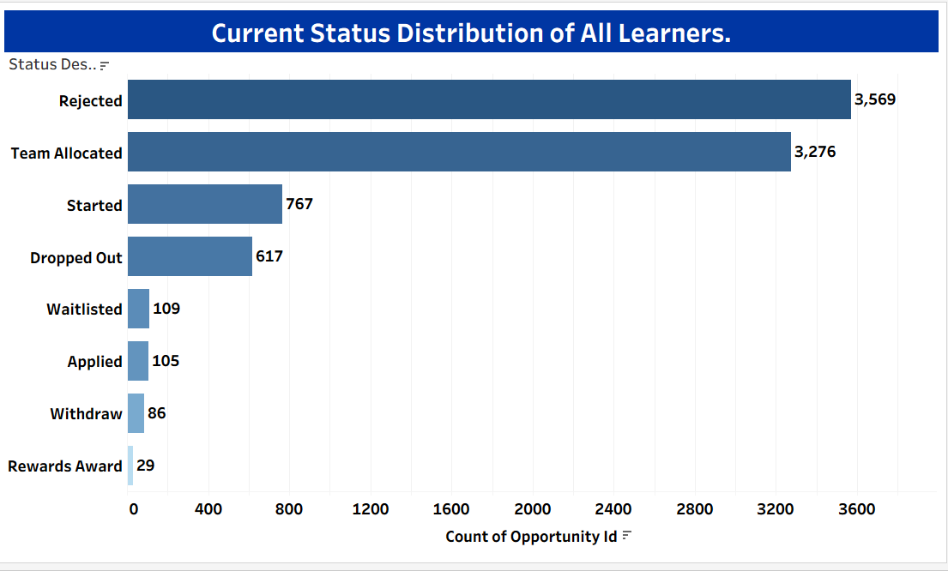
A lot of Learners Are Stuck Waiting for Teams
3,276 learners are "Allocated" to a team, but only 767 actually "Started".
80% of our "Active" users are just waiting to be onboarded.
These people didn't quit; our process stalled them.
We need to move people from "Allocated" to "Started" much faster.

Slide 5
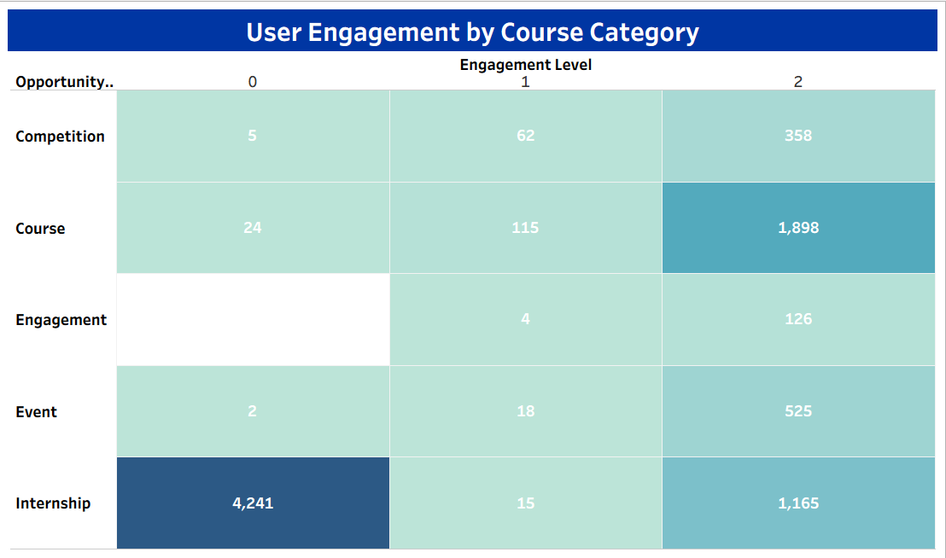
"Courses" Work Well; "Internships" Do Not
"Internships" have the most people, but 78% don't engage at all.
"Courses" have fewer people, but they stay active and finish.
People clearly prefer the "Course" structure.
We are spending money on Internships, but Courses give better results.

Slide 6
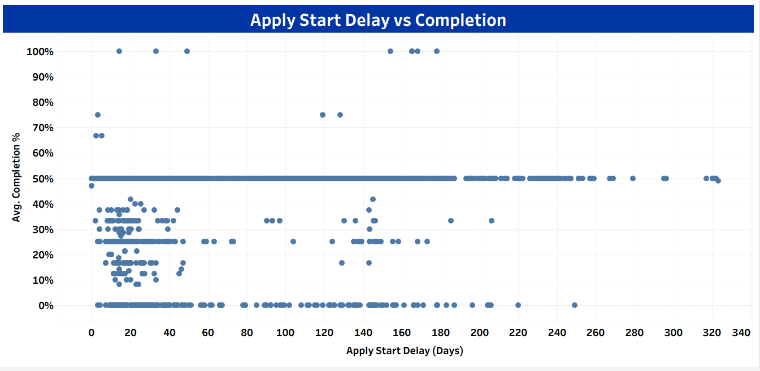
Waiting Time is the #1 Reason Learners Fail
The time between applying and starting is the biggest predictor of success.
The longer a student waits, the less likely they are to finish.
Applicants waiting 300+ days almost never finish.
Speed matters. Long wait times kill motivation.

Slide 7
Conclusion:
Recruiting is Good: We know how to get applicants.
Onboarding is Broken: Most learners fail because they wait too long to start.
Activity is Key: If they start quickly, they are more likely to finish.
The Fix: We must focus on starting learners faster, not just getting more applications.

Slide 8
Recommendations:
Fix the Wait: Check the 3,276 stuck students and automate their start process.
Start Day 1: Start new learners immediately so they don't lose interest.
Shift Focus: Move our budget from Internships to the successful "Course" tracks.
Be Honest: Stop calling waiting users "Active" so we see the real picture.

Slide 9
Team 4 Members:
Mulhuri Mugwambana (Team Lead)
Hamza Jawad (Project Lead)
Sifat Ishmam Parisa
Israel Dapo Olasinde
Kimanzi Jacob Mutie
Arimadu Chisom Precious
Oyeniran Micheal
Omoosumi Rilwan

Slide 10


